Slide 1
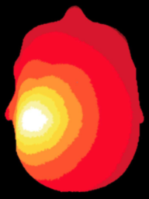
NeuroDOT
Tutorial:
Generating a Light Model
E.g., Pad_Adult_96x92.mat

Slide 2
NeuroDOT Set-Up - Checklist
Before starting any tutorial, please make sure you’ve done the following
Set your path so that all required folders and subfolders are included
Folders w/subfolders to include
NeuroDOT
Any other toolbox used for whatever task
Your personal directory
Folders to include
Output directory
Set your output directory so that you can save files to the desired location
Change your current directory to your output directory
cd(outputdir)

Slide 3


NeuroDOT Set-Up – Output Directory
Once you’ve set your path, the next thing you should do is set your output directory.
The output directory must be located within your path
If it isn’t already in your path, you must add it to your path
You can set your own path to an output directory in the line shown above
An output directory specifies the location where files will be saved
MATLAB, by default, will save files to the current directory
The following line of code will change your current directory to the output directory that you just specified →
Now you can save outputs

Slide 4
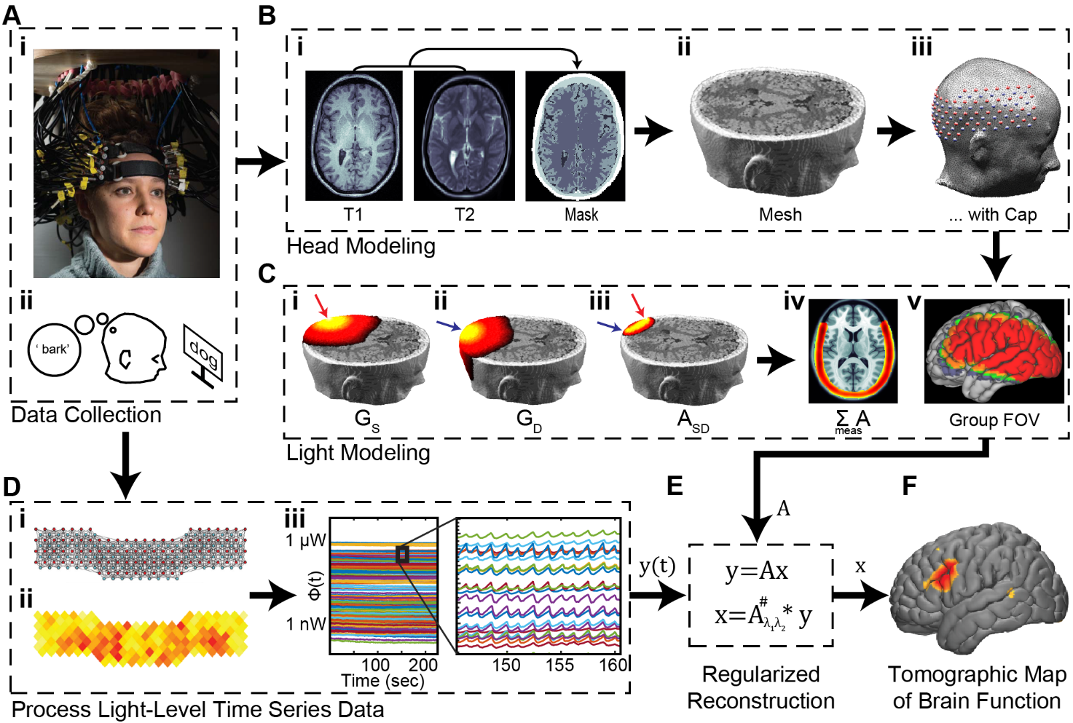
Diffuse Optical Tomography
In diffuse optical tomography (DOT), arrays of optical sources and detectors are used to perform functional neuroimaging experiments on task-based or resting state modes of human brain function.
Analyses are broken into several pipelines:
B: modeling of the tissue shape, optical property distribution, and source/detector locations
C: modeling of the light emission, diffusion, and detection through the head
D: preprocessing of the raw source-detector measurements
E: reconstruction and spectroscopy of the preprocessed data and light model into a functional neuroimaging volume
F: post-processing analysis of these results.

Slide 5
Generating a Light Model
This tutorial will follow the Script_for_Basic_Head_Modeling_Pad_Adult_96x92.m Matlab file which can be found in the Documentation/Scripts folder.
The tutorial will:
Generate a mesh from a segmented volume
Place an array of sources and detectors on the mesh
Set multiple parameters for the model
Calculate the sensitivity A for this model
We will use a segmented volume, Segmented_MNI152nl_on_MNI111, found in Support_Files/Atlases, to generate the head model.
We will use the visual pad, Pad_Adult_96x92.mat, found in Support_Files/Pad.

Slide 6
Generating a Light Model
It is recommended that if this is your first run through the NeuroDOT light modeling routine, you start with the other tutorial, NeuroDOT_Tutorial_Generating_a_Light_Model.
This tutorial runs through the same steps as the other, but with a larger grid of sources and detectors.
Additionally, the other tutorial provides more details on data structures and visualizations.
Generating the 96x92 light model will unlock the ability to visualize the reconstructed language paradigm data contained within the toolbox.

Slide 7
NeuroDOT Flowchart for
Light Model Generation
MRI Acquisition
Image Segmentation
Mesh Generation
Optode Placement
Calculate Sensitivity
Validate Sensitivity

Slide 8
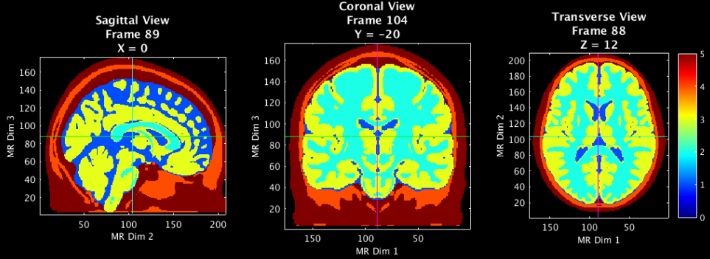
Load a Segmented volume and visualize
MRI Acquisition
[mask,infoT1]=LoadVolumetricData(['Segmented_MNI152nl_on_MNI111'],[],'4dfp');
p.Cmap='jet';p.Scale=5;p.Th.P=0;p.Th.N=-p.Th.P;p.PD=1;p.BG=[0,0,0];
PlotSlices(mask,infoT1,p) % Visualize the segmented mask
Image Segmentation
5 – Scalp
4 – Skull
3 – Gray Matter
2 – White Matter
1 – CSF
0 - Background

Slide 9
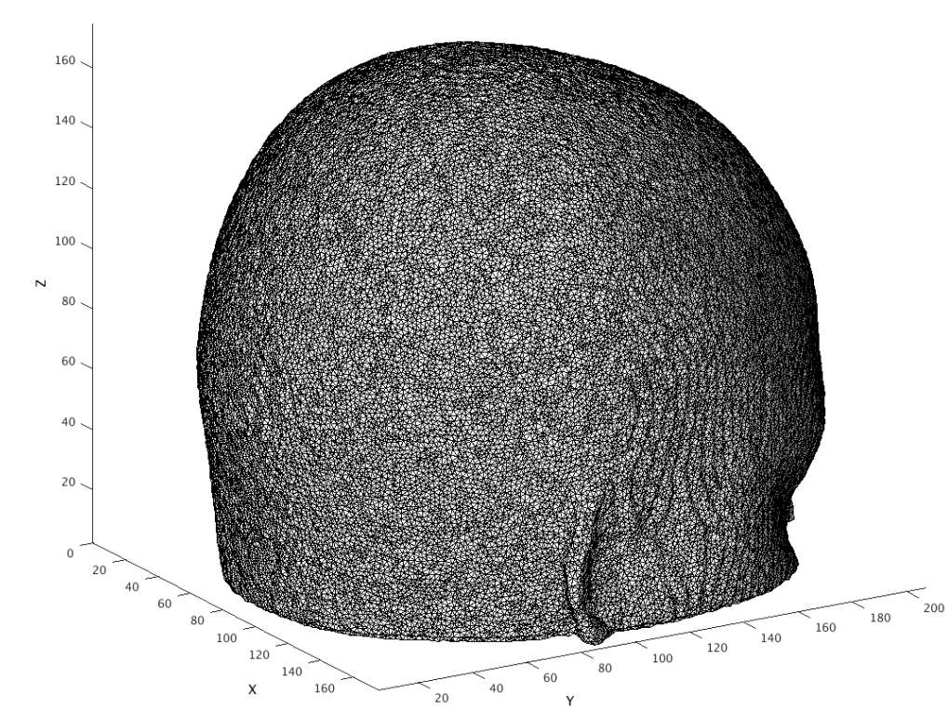
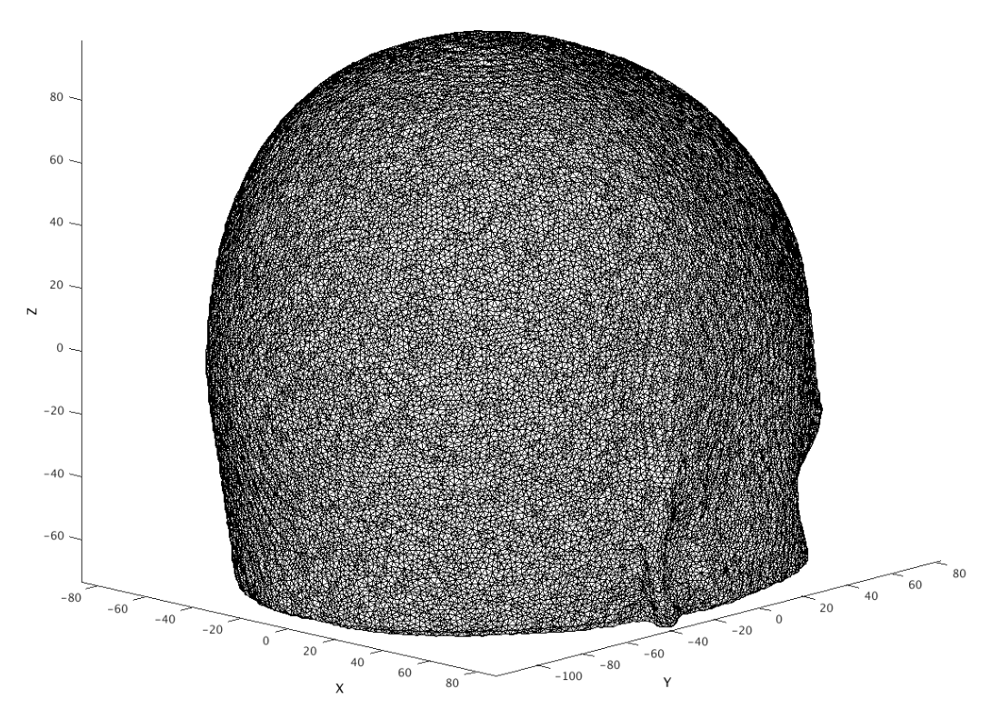
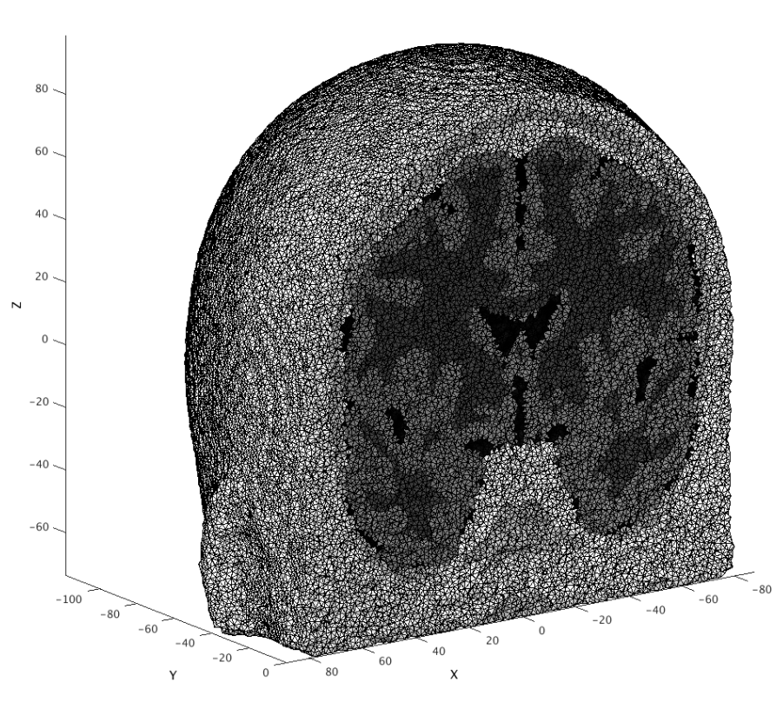
Generate a mesh and visualize
% Parameters for generating your mesh
meshname=['Example_Mesh']; % Provide a name for your mesh name here
param.facet_distance=0.75; % Node position error tolerance at boundary
param.facet_size =0.75; % boundary element size parameter
param.cell_size=1.4; % Volume element size parameter
param.info=infoT1;
param.Offset=[0,0,0];
param.r0=5; % nodes outside of mask must be set to scalp==5;
param.CheckMeshQuality=0;
param.Mode=0;
tic;mesh=NirfastMesh_Region(mask,meshname,param);toc
MRI Acquisition
Image Segmentation
Mesh Generation
“index space”
is non-negative
“coordinate space”
Usually has zeros in center of volume
A view inside

Slide 10
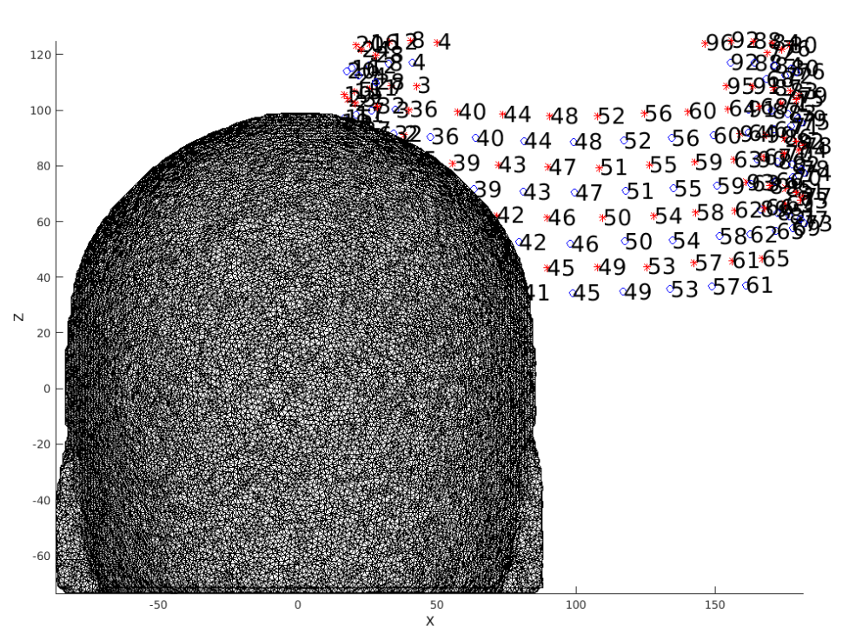
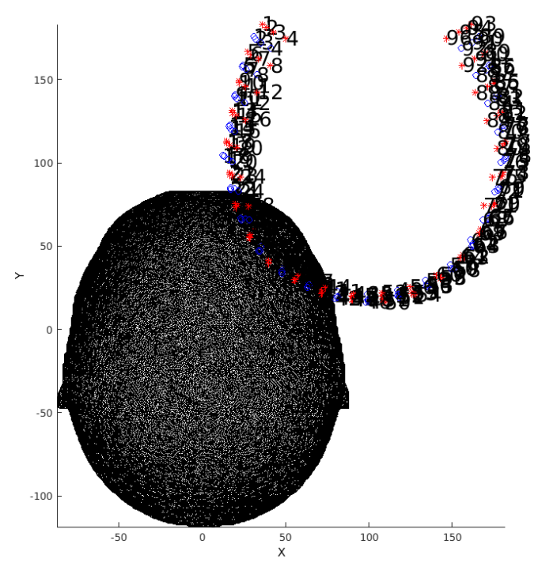
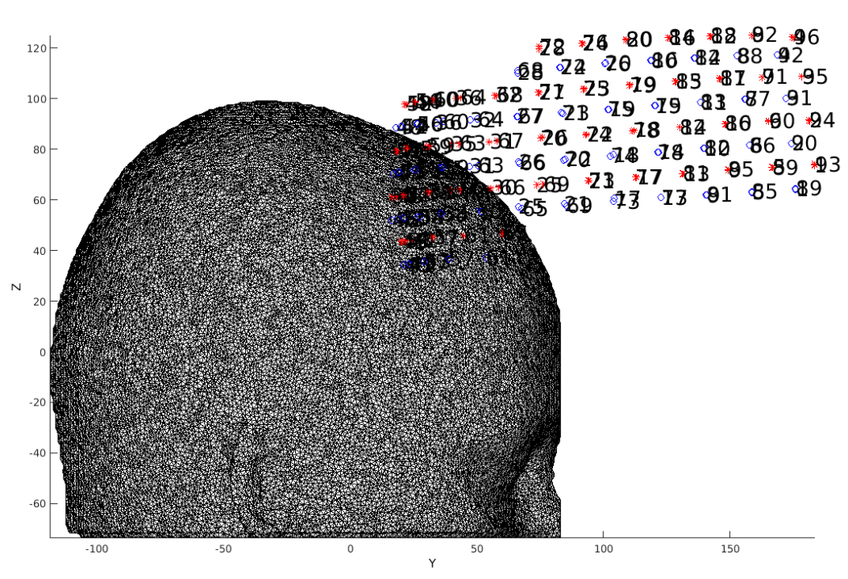
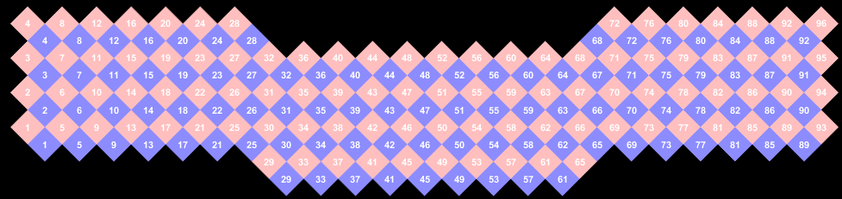
Place the optodes on the mesh (1 of 3)
Load in a Pad file for a grid design of interest, here the Adult_96x92 array.
MRI Acquisition
Image Segmentation
Mesh Generation
Optode Placement

Slide 11
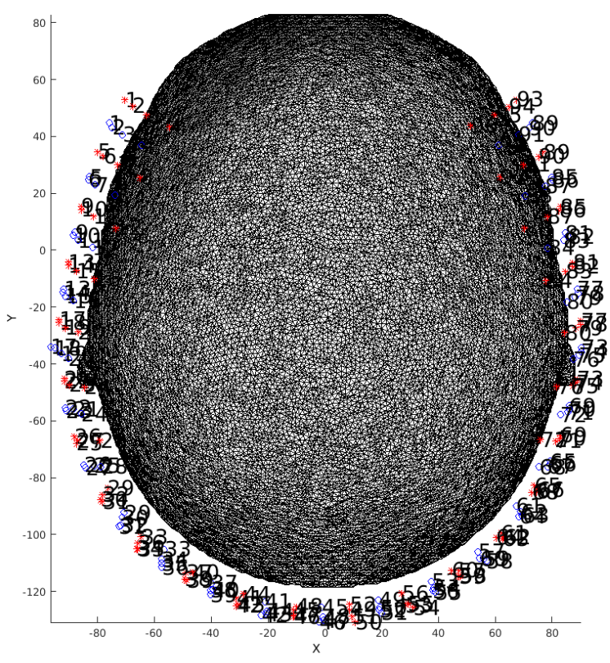
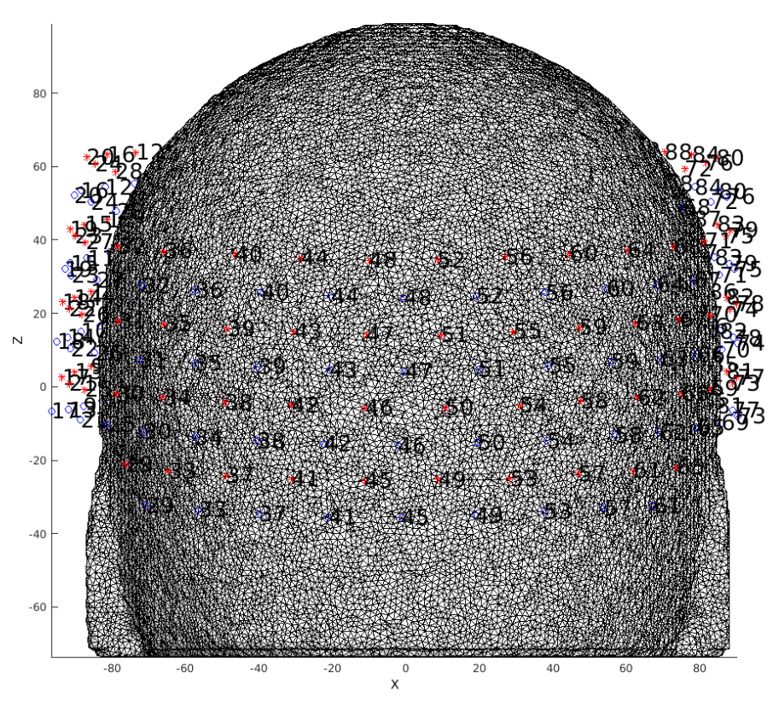
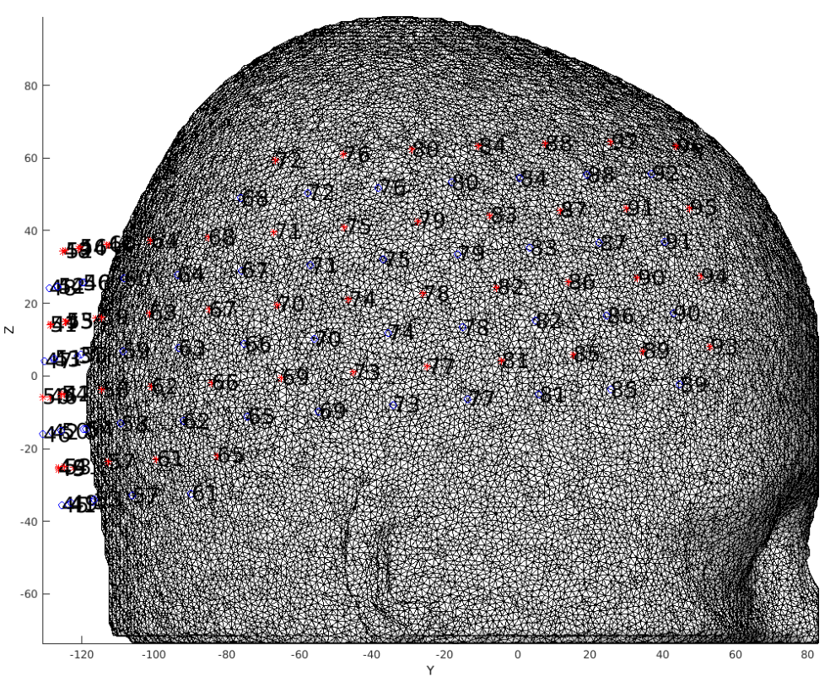
Place the optodes on the mesh (2 of 3)
Adjust array position by hand by altering parameters and re-visualizing mesh and array:
MRI Acquisition
Image Segmentation
Mesh Generation
Optode Placement

Slide 12
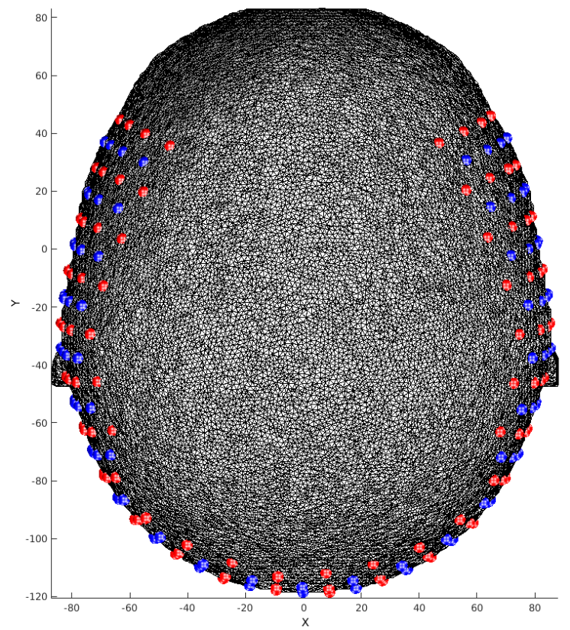
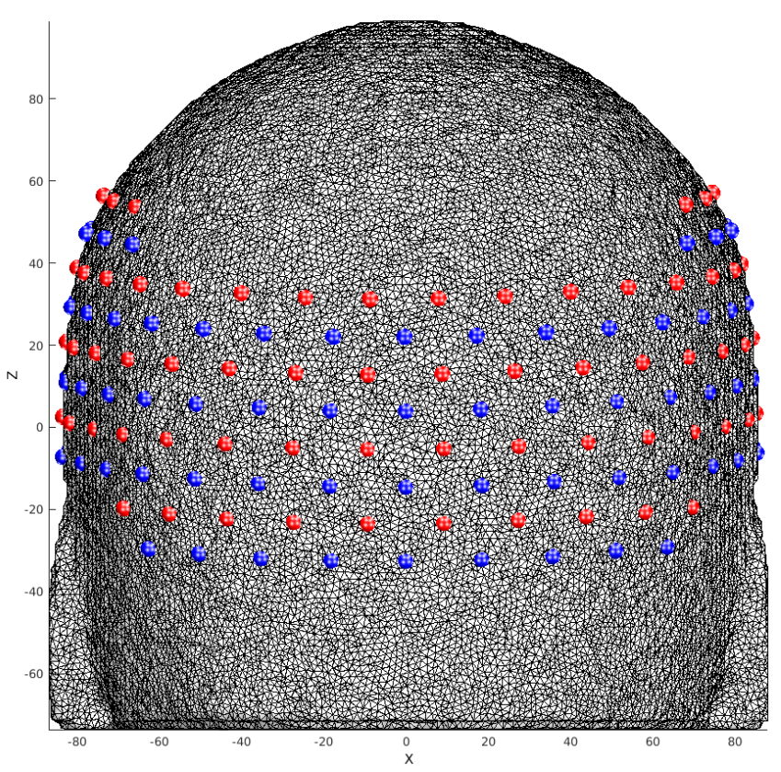
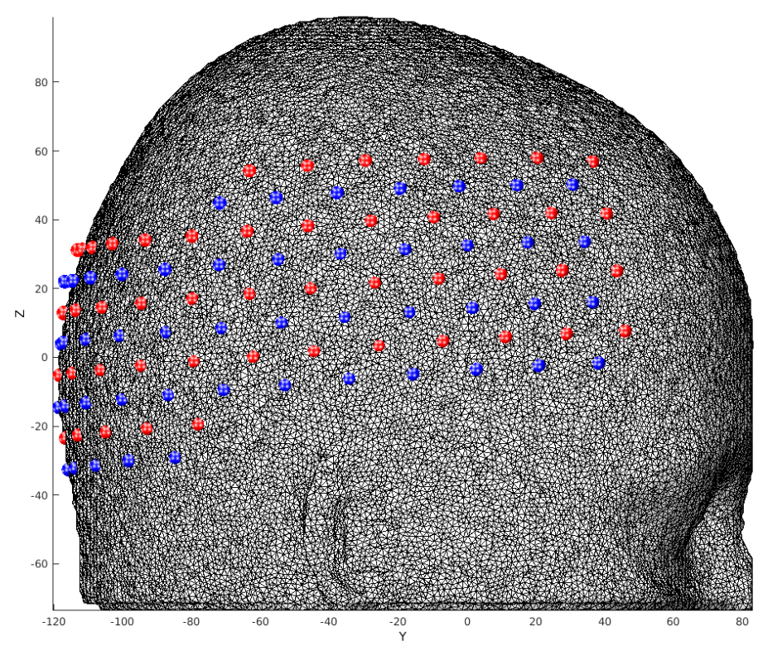
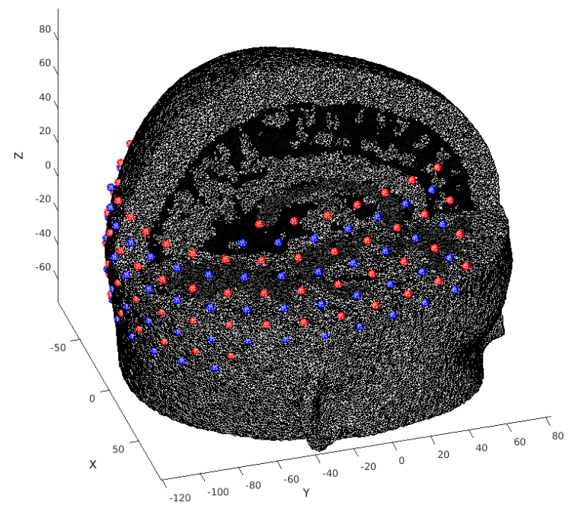
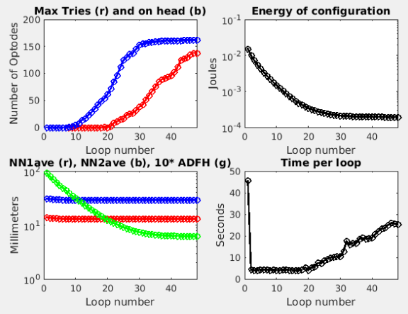
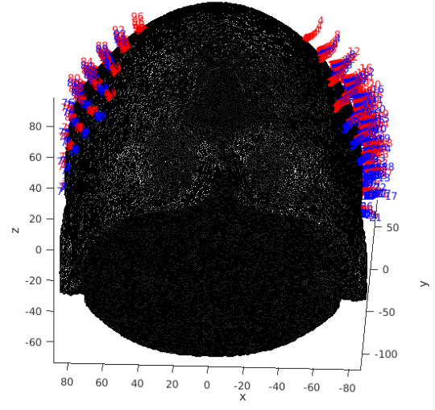
Place the optodes on the mesh (3 of 3)
4. Relax the grid on the head using the spring energy minimization algorithm
MRI Acquisition
Image Segmentation
Mesh Generation
Optode Placement

Slide 13
Calculate the sensitivity (1 of 3)
Prepare mesh and optode information for NIRFAST
gridname=padname;
mesh=PrepareMeshForNIRFAST(mesh,[meshname,'_',gridname],tposNew);
PlotMeshSurface(mesh,pM);PlotSD(mesh.source.coord(1:Ns,:),...
mesh.source.coord((Ns+1):end,:),'render',gcf);
Visualize cap and mesh to make extra sure you like the placement
MRI Acquisition
Image Segmentation
Mesh Generation
m3=CutMesh(mesh,intersect(find(mesh.nodes(:,3)>0),find(mesh.nodes(:,1)>0)));
[Ia,Ib]=ismember(m3.nodes,mesh.nodes,'rows');Ib(Ib==0)=[];
m3.region=mesh.region(Ib);
PlotMeshSurface(m3,pM);PlotSD(mesh.source.coord(1:Ns,:),...
mesh.source.coord((1+Ns):end,:),'render',gcf);
Optode Placement
Calculate Sensitivity

Slide 14
Calculate the sensitivity (2 of 3)
3. Set parameters for light modeling
flags.tag=[padname,'_on_',meshname,’_test’];
flags.gridname=gridname;
flags.meshname=meshname;
flags.head='info';
flags.info=infoT1; % Your T1 info file
flags.gthresh=1e-3; % Voxelation threshold in G
flags.voxmm=2; % Voxelation resolution (mm)
flags.labels.r1='csf'; % Regions for optical properties
flags.labels.r2='white';
flags.labels.r3='gray';
flags.labels.r4='bone';
flags.labels.r5='skin';
flags.op.lambda=[750,850]; % Wavelengths (nm)
flags.op.mua_skin=[0.0170,0.0190]; % Baseline absorption
flags.op.mua_bone=[0.0116,0.0139];
flags.op.mua_csf=[0.0040,0.0040];
flags.op.mua_gray=[0.0180,0.0192];
flags.op.mua_white=[0.0167,0.0208];
flags.op.musp_skin=[0.74,0.64]; % Baseline reduced scattering coeff
flags.op.musp_bone=[0.94,0.84];
flags.op.musp_csf=[0.3,0.3];
flags.op.musp_gray=[0.8359,0.6726];
flags.op.musp_white=[1.1908,1.0107];
flags.op.n_skin=[1.4,1.4]; % Index of refration
flags.op.n_bone=[1.4,1.4];
flags.op.n_csf=[1.4,1.4];
flags.op.n_gray=[1.4,1.4];
flags.op.n_white=[1.4,1.4];
flags.srcnum=Ns; % Number of sources
flags.t4=eye(4); % T1/dim to MNI atlas
flags.t4_target='MNI'; % string
flags.makeA=1; % if 0, don't make A, just make G
flags.Hz=0;
if flags.Hz, flags.tag = [flags.tag,'FD']; end
MRI Acquisition
Image Segmentation
Mesh Generation
Optode Placement
Calculate Sensitivity

Slide 15
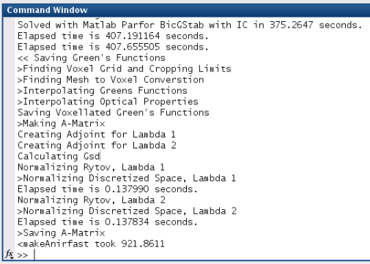
Calculate the sensitivity (3 of 3)
4. Calculate Green’s functions, voxelate, create sensitivity matrix, adjust bookkeeping.
Ti=tic;[A,dim]=makeAnirfast(mesh,flags); % size(A)= [Nwl, Nmeas, Nvox]
disp(['<makeAnirfast took ',num2str(toc(Ti))])
If successful, info like the below should show up in your command window:
MRI Acquisition
Image Segmentation
Mesh Generation
Optode Placement
Calculate Sensitivity

Slide 16
Package Sensitivity Matrix with associated info
5. Arrange A to have the same measurement list structure as the data:
[Nwl,Nmeas,Nvox]=size(A);
A=reshape(permute(A,[2,1,3]),Nwl*Nmeas,Nvox);
6. Place spatial information about light model in info.tissue structure:
info.tissue.dim=dim;
info.tissue.affine=flags.t4;
info.tissue.infoT1=infoT1;
info.tissue.affine_target='MNI';
info.tissue.flags=flags;
7. To save disk space, remove measurements beyond 5th nearest neighbors:
keep=info.pairs.NN<=5;
temp=table;
temp.Src=info.pairs.Src(keep);
temp.Det=info.pairs.Det(keep);
temp.NN=info.pairs.NN(keep);
temp.WL=info.pairs.WL(keep);
temp.lambda=info.pairs.lambda(keep);
temp.Mod=info.pairs.Mod(keep);
temp.r2d=info.pairs.r2d(keep);
temp.r3d=info.pairs.r3d(keep);
info.pairs=temp;
A=A(keep,:);
save(['A_',flags.tag,'.mat'],'A','info','-v7.3')
MRI Acquisition
Image Segmentation
Mesh Generation
Optode Placement
Calculate Sensitivity

Slide 17
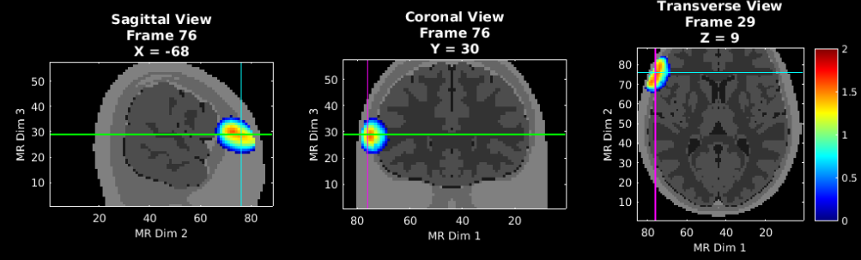
Validate the sensitivity (1 of 2)
Visualize an example measurement’s sensitivity
% Visualize aspects of sensitivity profile
t1=affine3d_img(mask,infoT1,dim,eye(4)); % put anatomical volume in dim space
keep=info.pairs.WL==2 & info.pairs.Src==1 & info.pairs.Det==6; % Single meas pair
foo=squeeze(A(keep,:));
fooV=Good_Vox2vol(foo,dim);
fooV=fooV./max(fooV(:));
fooV=log10(1e2.*fooV); % top 2 orders of magnitude.
pA.PD=1;pA.Scale=2;pA.Th.P=0;pA.Th.N=-pA.Th.P;
PlotSlices(t1,dim,pA,fooV)
MRI Acquisition
Image Segmentation
Mesh Generation
Optode Placement
NN2: source 1 detector 6
Calculate Sensitivity
Validate Sensitivity

Slide 18
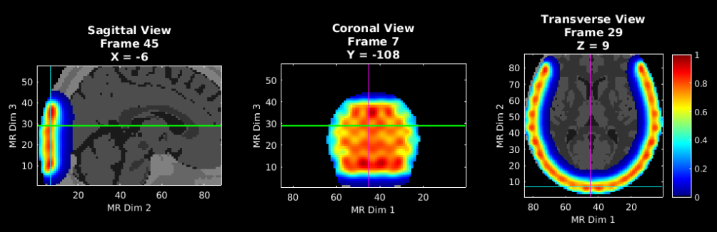
Validate the sensitivity (2 of 2)
Visualize the flat field reconstruction
keep=(info.pairs.WL==2 & info.pairs.r2d<=40);
a=squeeze(A(keep,:));
iA=Tikhonov_invert_Amat(a,0.01,0.1);
iA=smooth_Amat(iA,dim,3);
ffr=makeFlatFieldRecon(a,iA);
fooV=Good_Vox2vol(ffr,dim);
fooV=fooV./max(fooV(:));
pA.PD=1;pA.Scale=1;pA.Th.P=1e-2;pA.Th.N=-pA.Th.P;
PlotSlices(t1,dim,pA,fooV)
MRI Acquisition
Image Segmentation
Mesh Generation
Optode Placement
Calculate Sensitivity
Validate Sensitivity

Slide 19
Appendix: Generating info for Pad file (1 of 3)
The Pad file for a given grid design contains a structure variable info that contains the spatial and topological information for the array as follows:
info.optodes
Structure containing spatial coordinates for sources and detectors in array
info.optodes.spos2 – 2D coordinates of each sources
info.optodes.spos3 – 3D coordinates of each source
info.optodes.dpos2 – 2D coordinates of each detector
info.optodes.dpos3 – 3D coordinates of each detector
info.pairs
Table containing topological information for each source-detector measurement pair
Each row of this table corresponds to a measurement and must be in the same order as the optical data for valid processing
Generally, full list of sources and detectors is repeated for each wavelength/lambda.
info.pairs.Src – source in measurement
info.pairs.Det – detector in measurement
info.pairs.NN – Nearest Neighbor class in array (e.g., info.pairs.NN=1 means this measurement is one of the closest in the grid design)
info.pairs.WL – wavelength index of measurement
info.pairs.lambda – actual wavelength of measurement (e.g., info.pairs.lambda-=750 is a 750 nm measurement)
info.pairs.Mod – Modulation type of measurement (e.g., ‘CW’, or, ‘FD’)
info.pairs.r2d – 2D source-detector distances
info.pairs.r3d – 3D source-detector distances

Slide 20
Appendix: Generating info for Pad file (2 of 3)
If you already have a grid design with 2D and 3D source and detector locations, saved as the following:
grid.spos2
grid.spos3
grid.dpos2
grid.dpos3
To generate the topology structure for your grid:
dr=5; % Distance separating 'nearest neighbor' groups
Rad=Grid2Radius_180824(grid,dr);
Once you have the grid and radius set up (as above), the info structure can be generated with the following:
grid.name='Your_Grid_Name';
params.lambda=[750,850]; % Wavelengths for your system
params.Mod='CW'; % Modulation strategy
[info]=Generate_Info_from_Grid_Rad(grid,Rad,params);
Then just save the Pad file for future use:
save(['Pad_',info.optodes.CapName],'info')

Slide 21
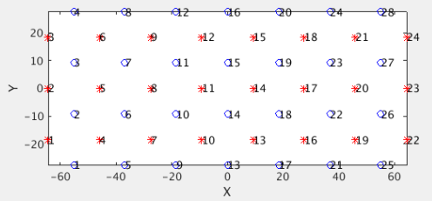
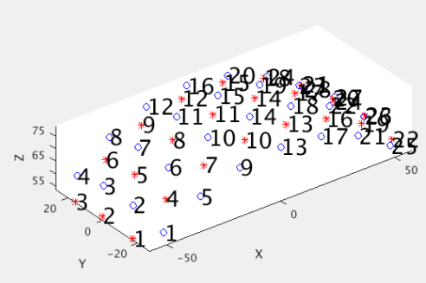
Appendix: Generating info for Pad file (3 of 3)
If instead you are designing a grid from scratch in style of our visual cap:
Ndy=4; % Num detectors in y-direction
Ndx=7; % Num detectors in x-direction
NN1sep=13; % Closest source-detector Separation
Srad=80; % Radius of spherical head model
[grid,Rad]=Make_Sphere_Cap(Ndy,Ndx,NN1sep,Srad);
As described above,
grid contains information on the positions of the sources and detectors.
Rad contains information on the topology of the array.
Visualize the grid in 2D and 3D
PlotSD(grid.spos2,grid.dpos2,'norm'); % Visualize 2D positions
PlotSD(grid.spos3,grid.dpos3,'norm'); % Visualize 3D positions
Then set parameters, generate info file as on previous slide, and save Pad file for future use.

Slide 22
That’s It (For Now)
Congratulations! You have finished the NeuroDOT Generating a Light Model (PAD Adult 96x92) Tutorial
You are now ready to start the other NeuroDOT Tutorials
Recommended order for the tutorials is:
Generating a Light Model
Preprocessing
Image Reconstruction
Full Data Processing
Generating a Light Model PAD Adult 96x92
If you have any questions about the material presented in this tutorial, please consult the NeuroDOT User Manual on the WUSTL Optical Radiology Lab (ORL) GitHub page https://github.com/WUSTL-ORL/NeuroDOT_Beta in the documentation folder, or contact either: Adam Eggebrecht: aeggebre@wustl.edu, Emma Speh: espeh@wustl.edu, Ari Segel: ari@wustl.edu, or Jason Trobaugh: jasont@wustl.edu

